Slide 1
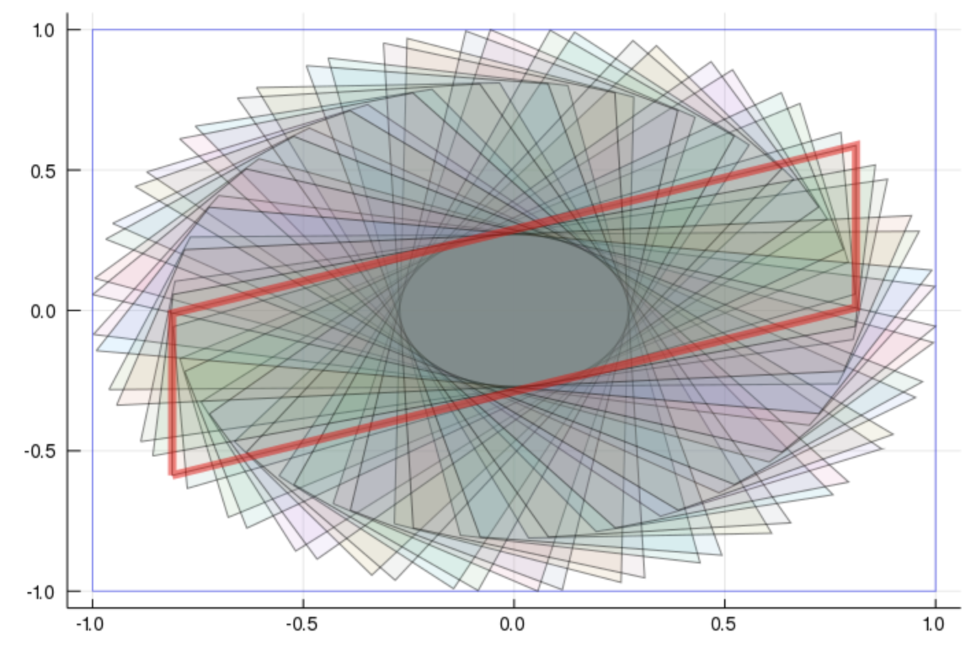
Computing Invariant Set via Zonotopes and some optimization tools in Julia
Helen Zhang

Slide 2
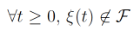
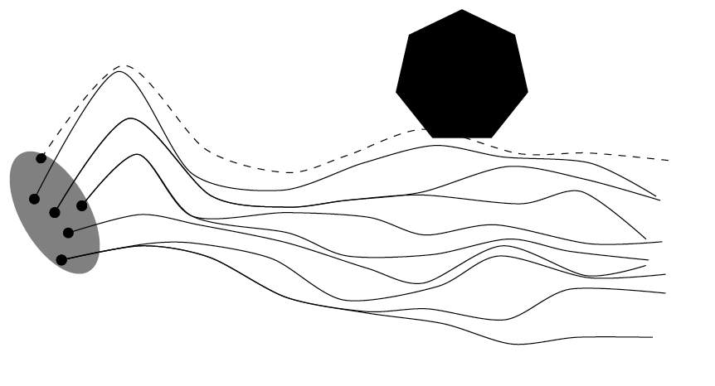
Motivation
Consider a continuous dynamical system:
A trajectory ξ is said to be safe if it does not intersect a bad set F:
If F is avoided, then the system is said to be safe.
[Le Guernic, 2009]
Notes:
X is the state space and u is a input signals.
One property of interest is the safety property. The set F is a region of the state space we want to avoid.
As an example, we do not want an airplane to fly below its stalling speed, or the temperature of the core of a nuclear reactor to heat beyond the critical fuel surface temperature.

Slide 3
Reachability Analysis of Hybrid Systems with Linear Continuous Dynamics
--Colas Le Guernic. Computer Science [cs]. Université Joseph-Fourier - Grenoble I, 2009. English. .tel-00422569v1
Methods of proving safety:
Simulations
Barrier Certificates
Reachability

Slide 4
Simulation
Exhaustive analysis
Statistical method
Generate a finite set of trajectories to that will exhibit all the behaviors of the system
[Le Guernic, 2009]
Notes:
If the set of initial conditions and the set of input signals are finite, it is possible to analyze the system exhaustively
Checking a sufficient (finite) number of randomly chosen trajectories might give sufficient confidence. Quick and cheap, but can’t guarantee safety
Any state reachable by the original system is at a bounded distance from one of the chosen trajectories

Slide 5
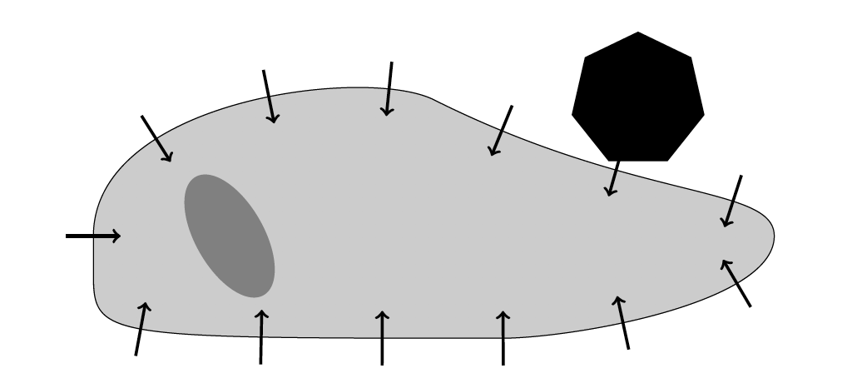
Barrier Certificates:
Search for a surface, separating the set of initial points and the bad set, which cannot be crossed by any trajectory.
[Le Guernic, 2009]
Notes:
Can guarantee the safety of a system over an infinite time horizon, but might be hard to find

Slide 6
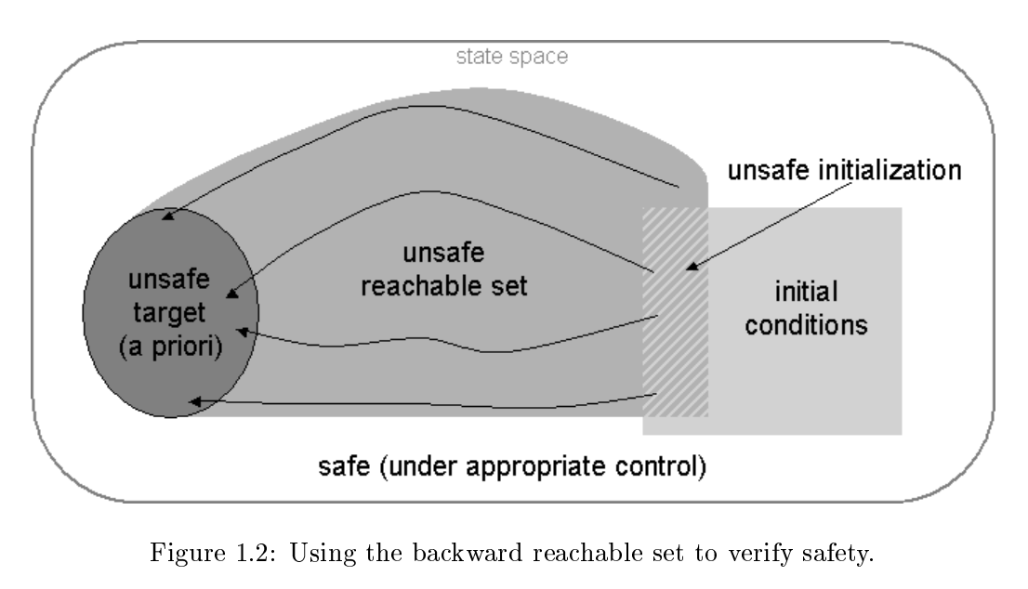
Reachability
“Given a computational (potentially infinite state) system with a set of allowed rules or transformations, decide whether a certain state of a system is reachable from a given initial state of the system.”
-- Wikipedia “Reachability problem”
[Mitchell, 2002]
Notes:
We want to compute the reachable set, but its often impossible to compute. Instead we compute approximations of this set.
In order to be able to do some computations one must first choose a class of sets with a good representation.

Slide 7
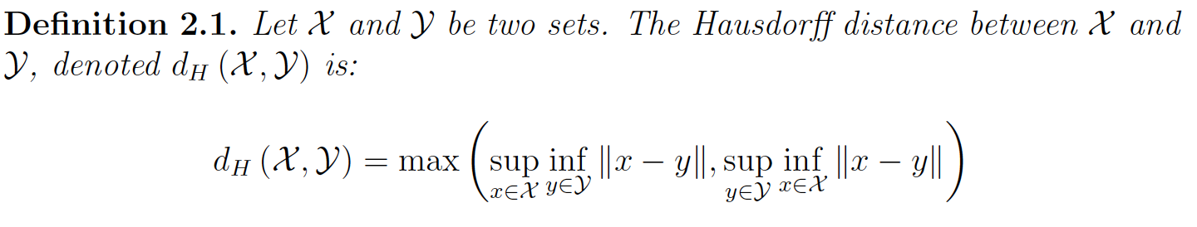
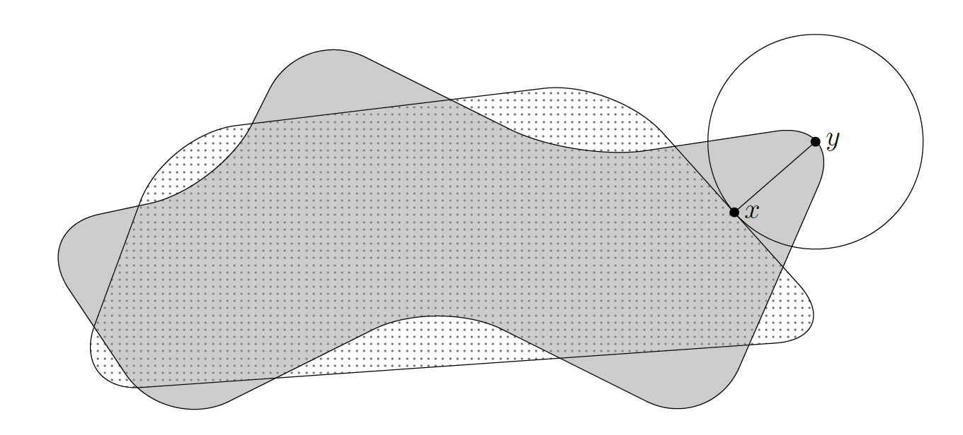
Hausdorff distance
[Le Guernic, 2009]

Slide 8
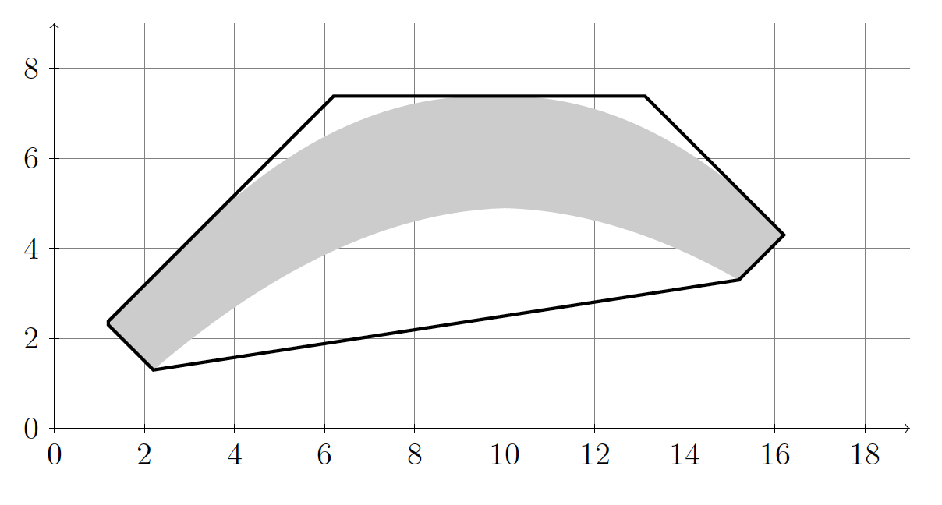
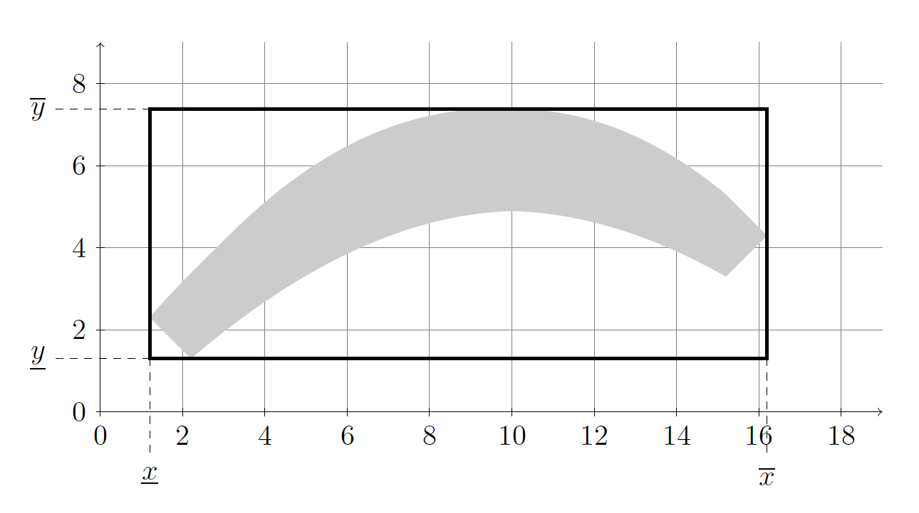
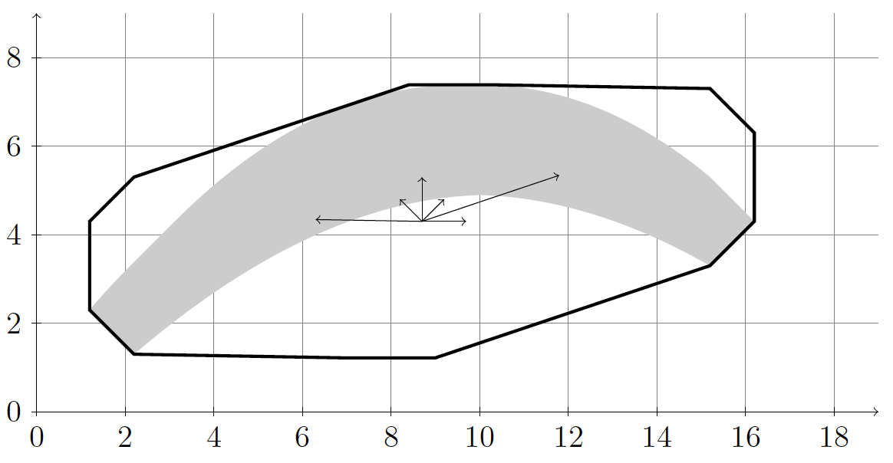
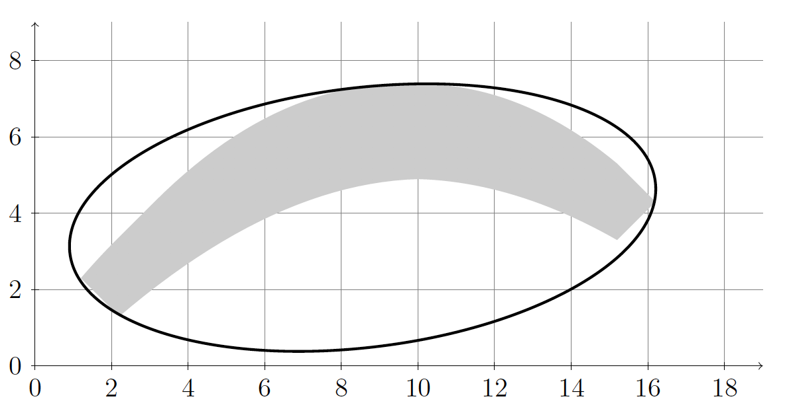
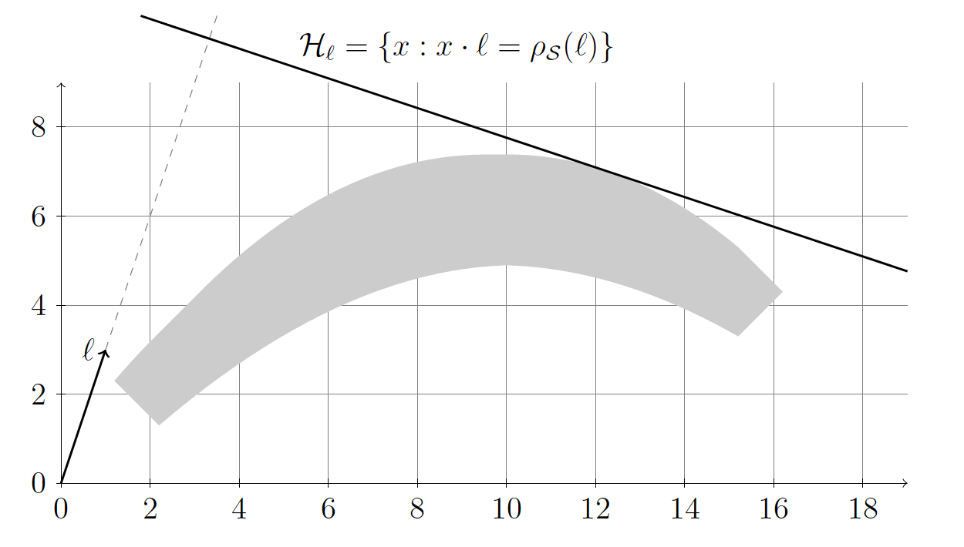
Set representation
Polytopes
Zonotopes
Support Functions
Boxes (Interval Hall)
Ellipsoids
[Le Guernic, 2009]

Slide 9
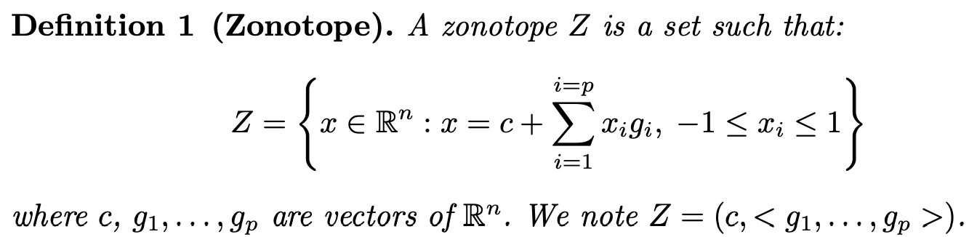
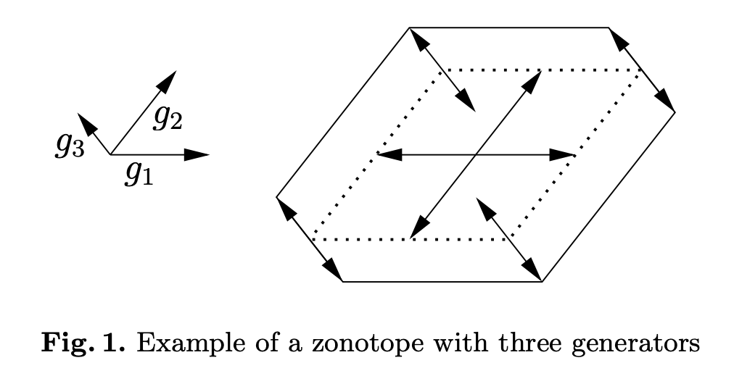
Zonotope
special class of convex polytopes.
image of a cube under an affine projection
Minkowski sum of a finite set of line segments.
[Girard, 2005]

Slide 10
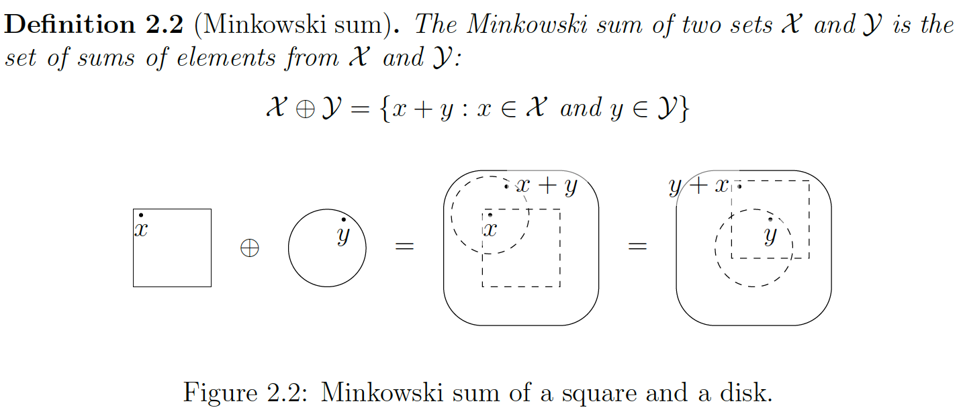
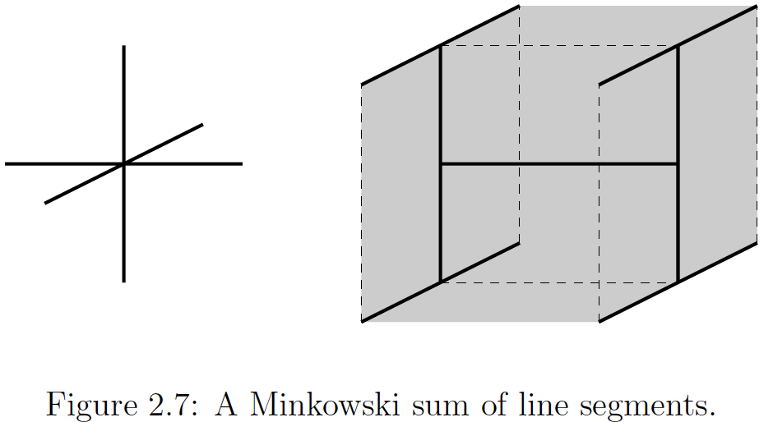
Minkowski sum
[Le Guernic, 2009]

Slide 11
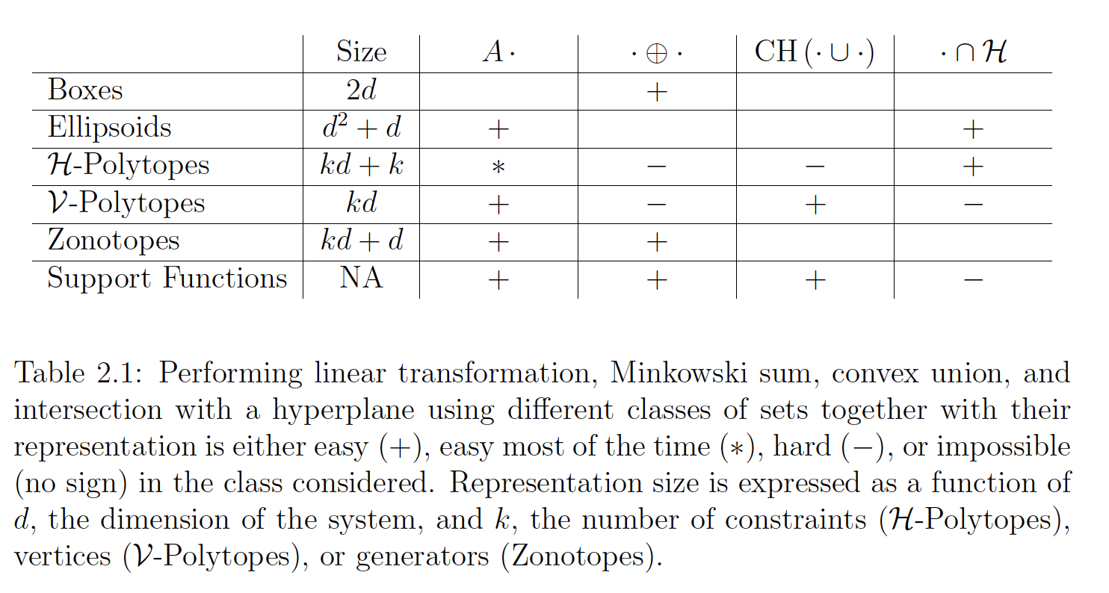
The main operations we will need are linear transformation, Minkowski sum, convex union, and intersection with a hyperplane.
[Le Guernic, 2009]
Notes:
Table 2.1 informally summarizes the difficulty of performing these operations in each of the classes presented in the previous section.

Slide 12
Invariant, Viability and Discriminating Kernel Under-Approximation via Zonotope Scaling Ian M. Mitchell, Jacob Budzis, Andriy Bolyachevets

Slide 13
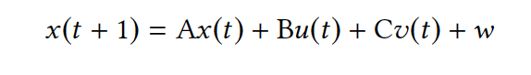
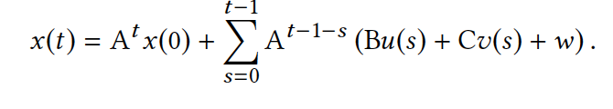
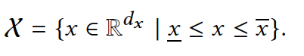
System Dynamics
Consider a discrete time dynamic system for times t = 0, 1, 2, …
We will formulate our safety verification problem as keeping the system state within a constraint set X.
[Mitchell, 2007]

Slide 14
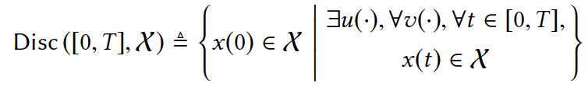
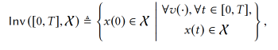
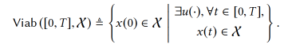
Sets of Interest for Safety Verification
Discriminating or robust controlled invariant set:
For systems which lack a control input, we seek a finite horizon invariant set:
For systems which lack a disturbance input we seek a finite horizon viable or controlled invariant set:
[Mitchell, 2007]

Slide 15
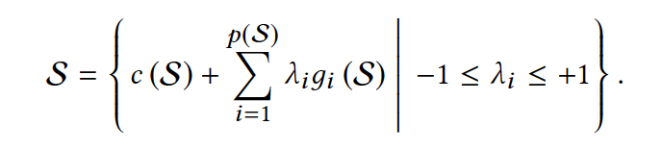
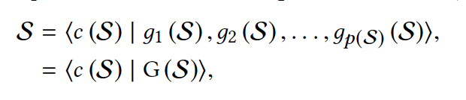
Set Representation: Zonotopes
We will use zonotopes as our parametric representation of invariant, viable and/or discriminating sets.
In most cases it is more convenient to work with the center-generator tuple:
[Mitchell, 2007]

Slide 16
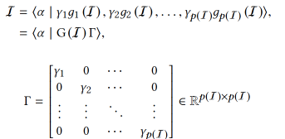
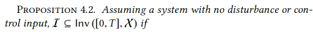
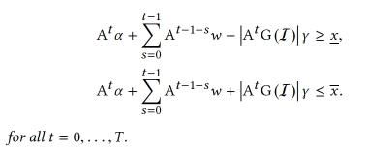
Computing Invariant set: With no input
Consider a parameterized zonotope I :
[Mitchell, 2007]
Notes:
T is the diagonal matrix with vector along its diagonal. G is a specified set of generators, but the
center vector and generator scaling vector are free parameters.
Each element of is associated with a generator of I and can be thought of intuitively as the “width” of I in that generator direction.
Proposition 4.1: Assuming a system with no disturbance or control input, the reach set for an initial state space zonotope I can be represented by a center, generator count and generator matrix given by:

Slide 17
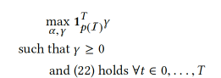
Optimization Objective
Ideally, we would then seek the set I of maximum volume which satisfies above constrains.
But it is combinatorically complex in number of generators.
Simpler Heuristic:
Maximizing the sum of the elements of 𝜸 (sum of the “widths” of the generators)
[Mitchell, 2007]

Slide 18
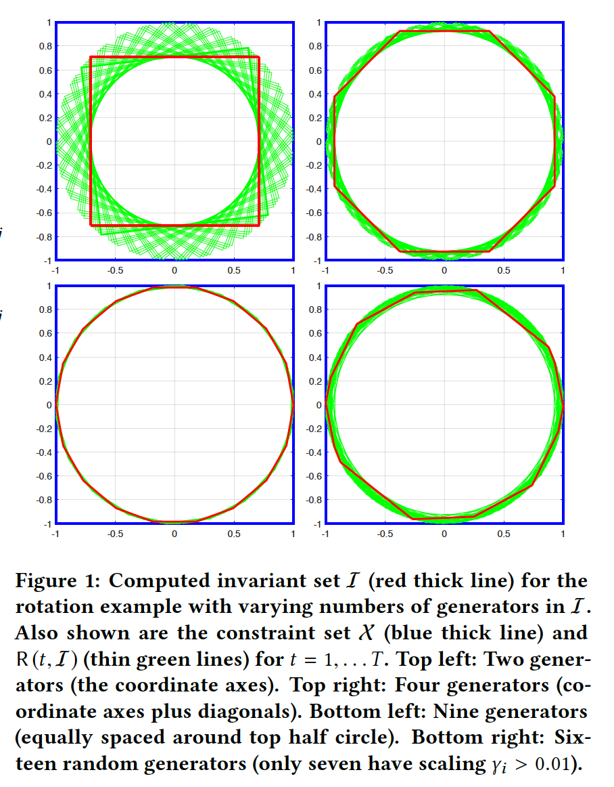
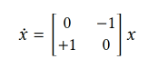
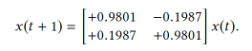
Example: Rotational Dynamics
Consider the system:
we use the matrix exponential with time step 0.2 to construct the
discrete time system
compute an invariant set after slightly more than one full rotation.
[Mitchell, 2007]

Slide 19
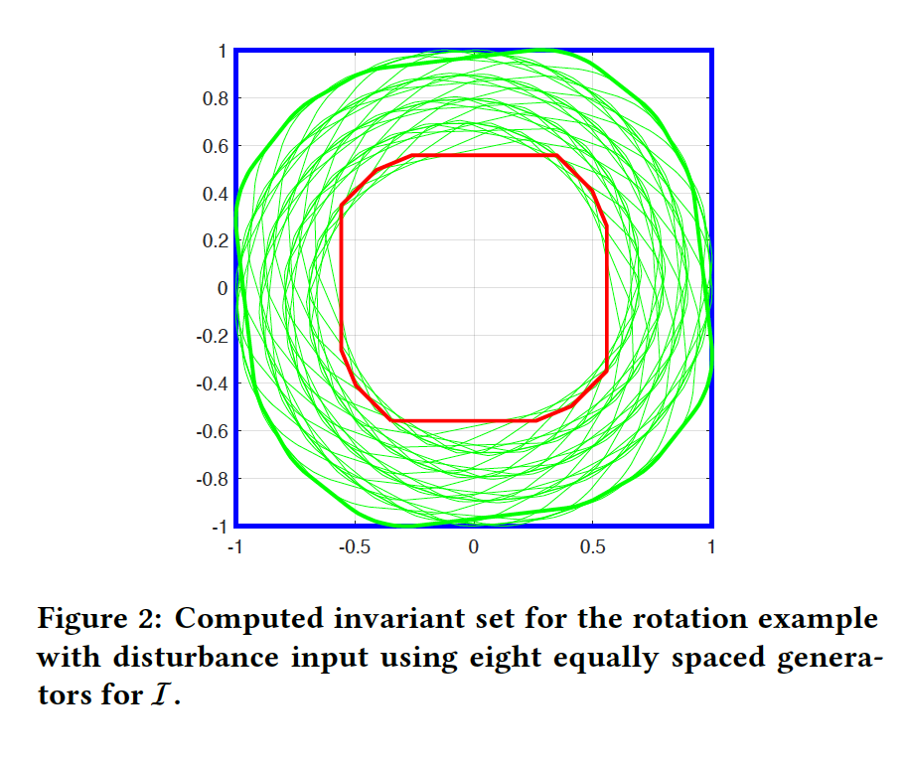
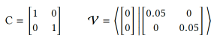
Example: Rotational Dynamics
Same system with disturbance:
[Mitchell, 2007]

Slide 20
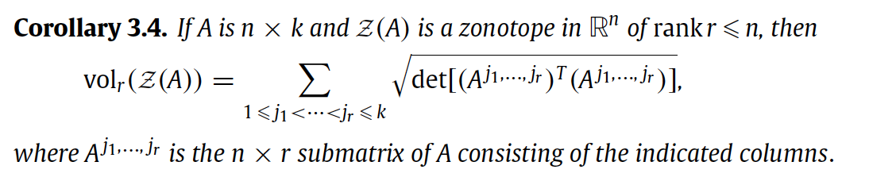
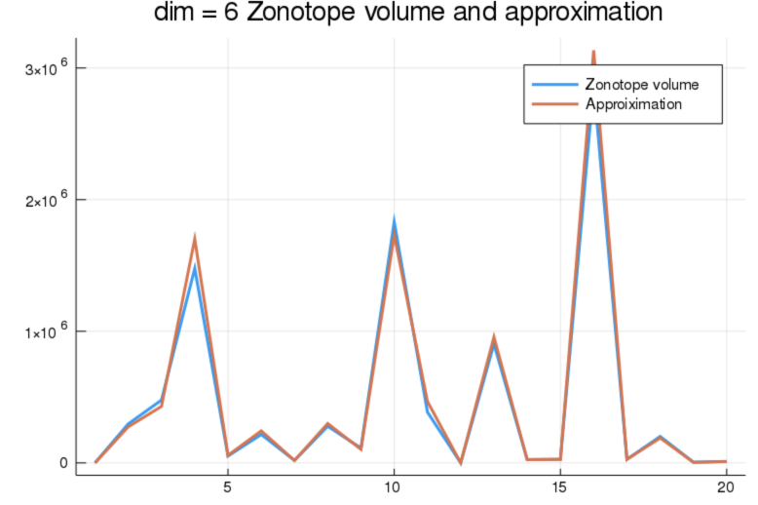
Zonotopes Volume
[Gover, 2010]
Testing Method:
Find the bounding box and its volume of a zonotope
Sample random points in the box
Use the percentage of points inside the zonotope to approximate the volume of the zonotope

Slide 21
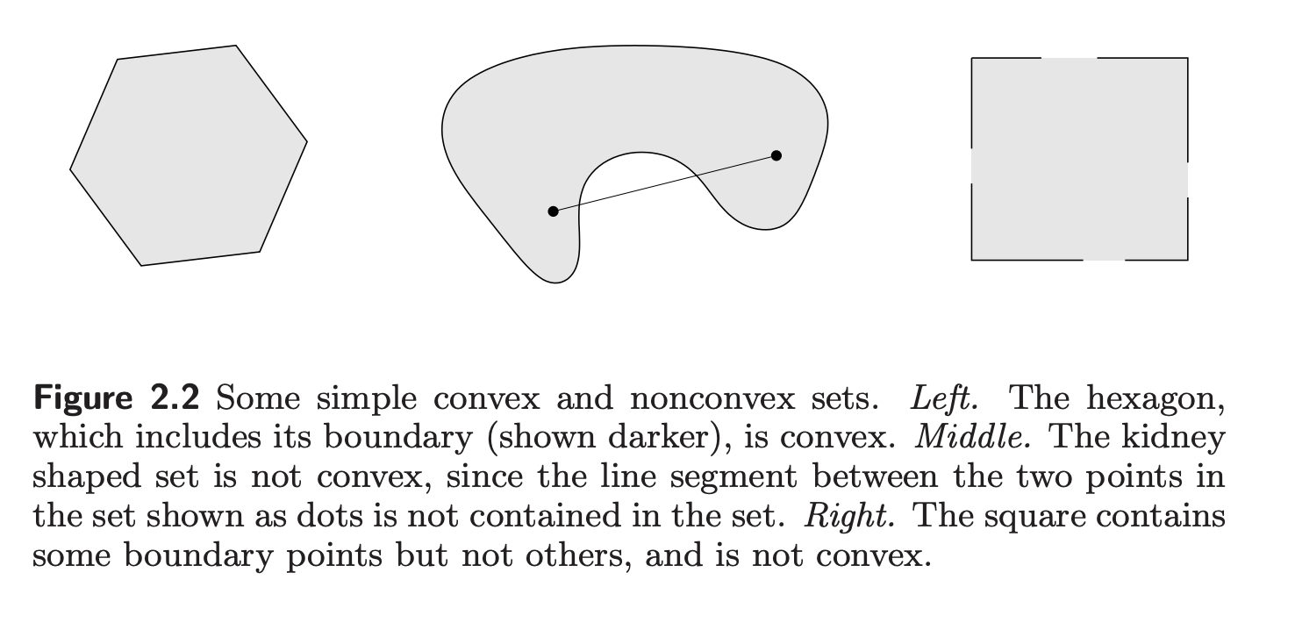
Convex set
[Boyd, 2004]

Slide 22
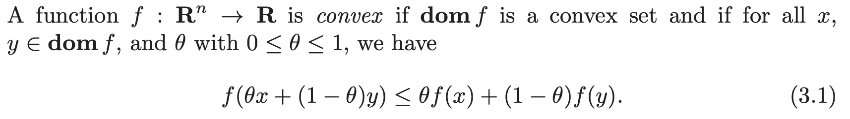
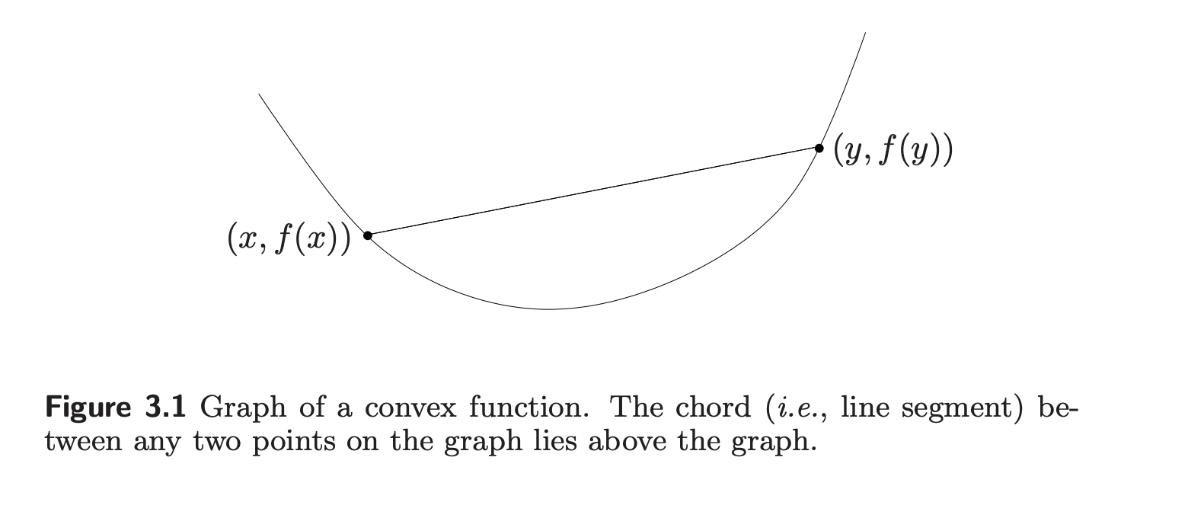
Convex function
[Boyd, 2004]

Slide 23
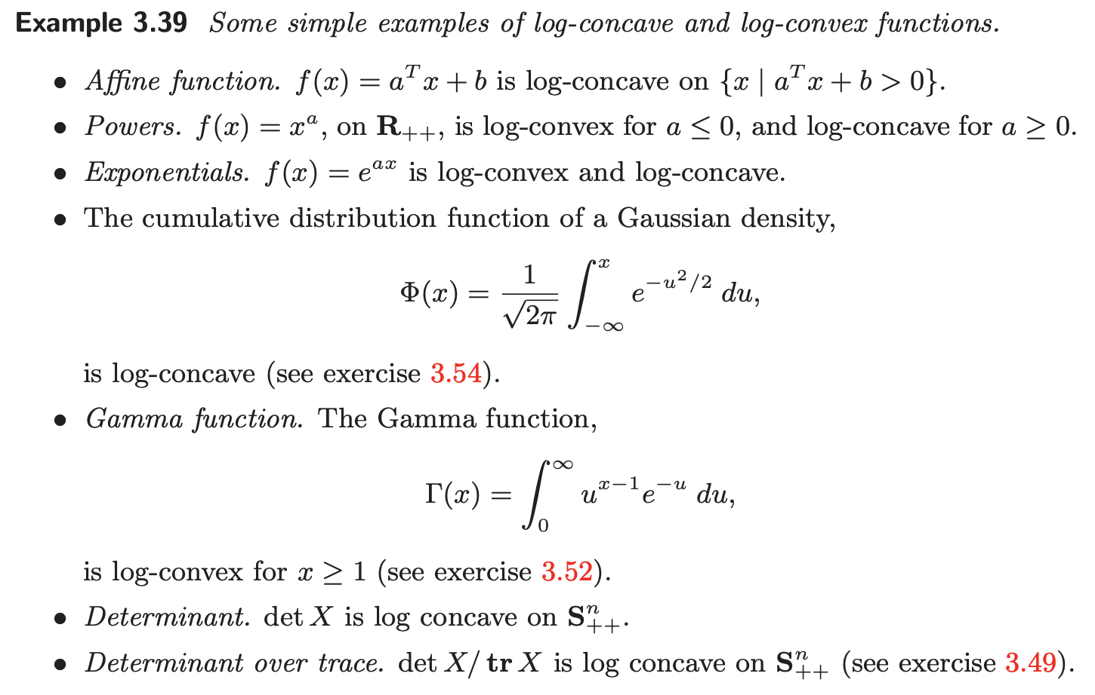
Convex function
[Boyd, 2004]

Slide 24
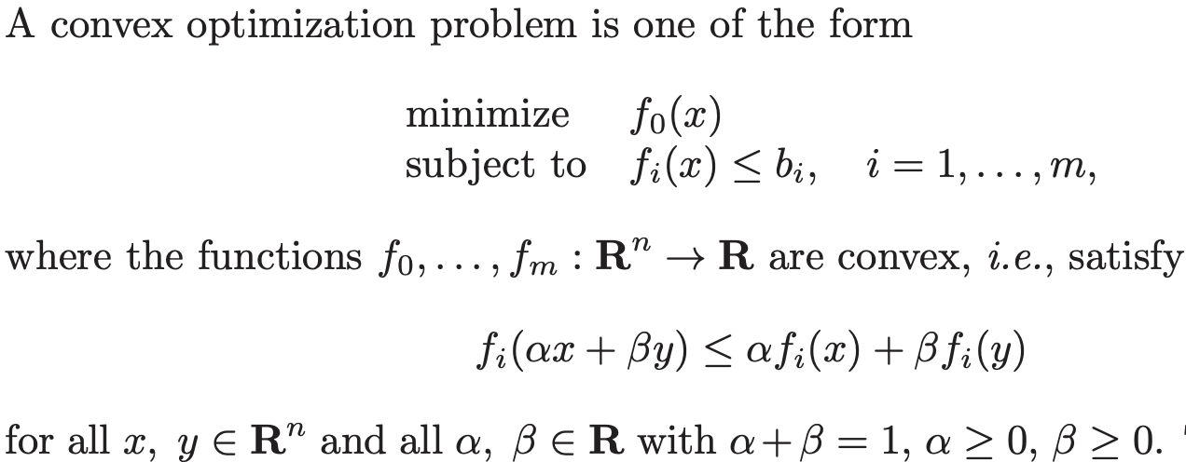
Convex Optimization
[Boyd, 2004]

Slide 25
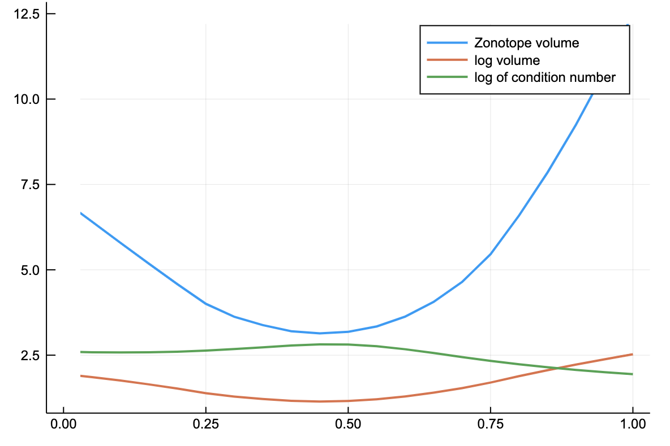
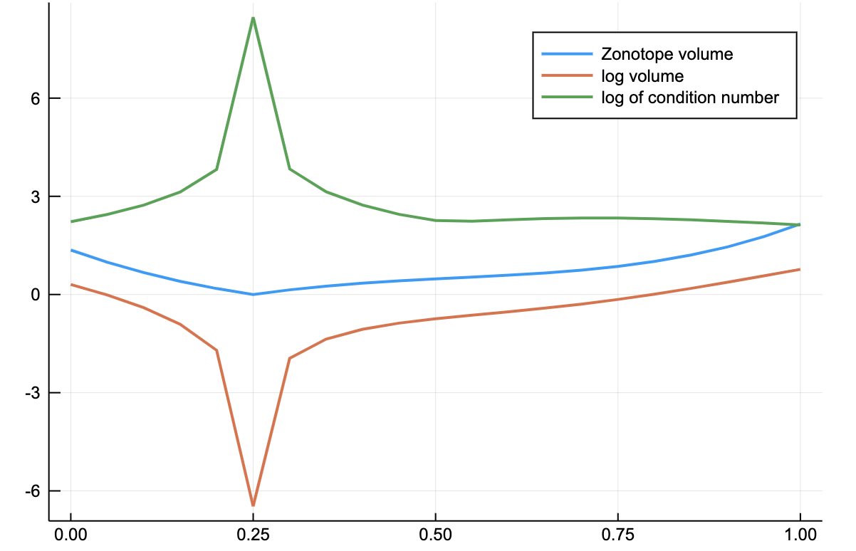
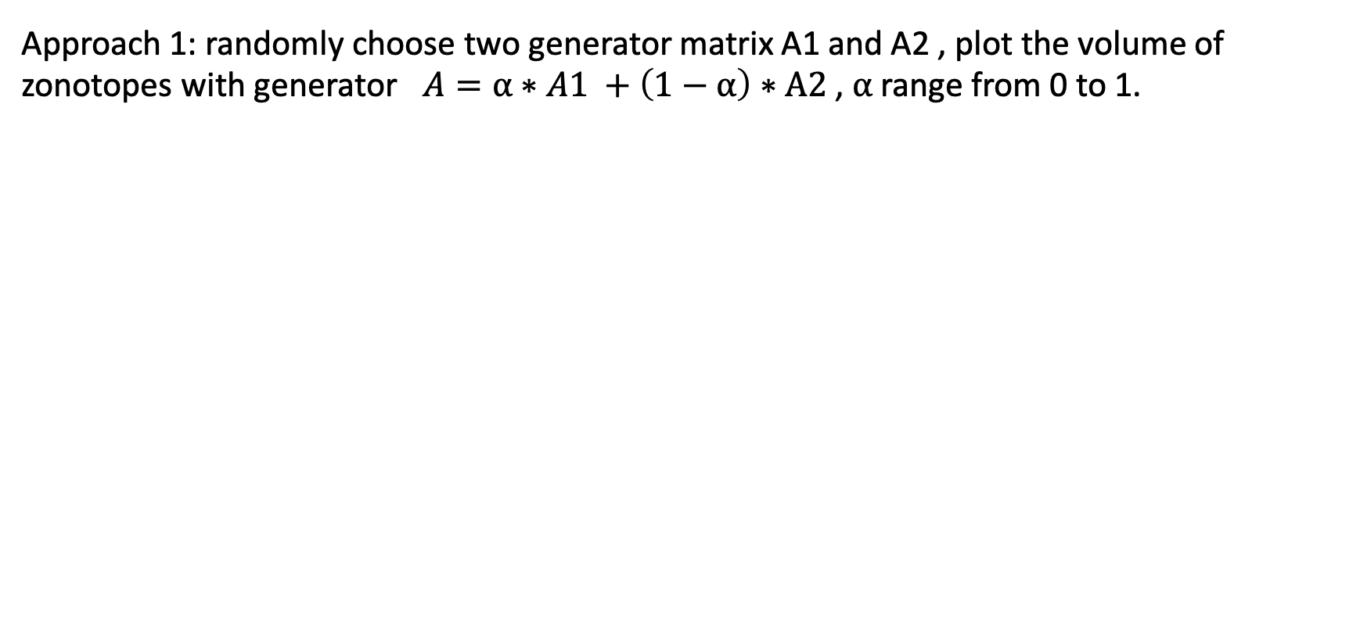
…Is zonotope volme a convex/concave function?
Approach 1: randomly choose two generator matrix A1 and A2 , plot the volume of zonotopes with generator $A=⍺∗A1 +\left(1−⍺\right)∗A2$, $⍺$ range from 0 to 1.
But when the condition number is too high, volume shrinks to zero

Slide 26
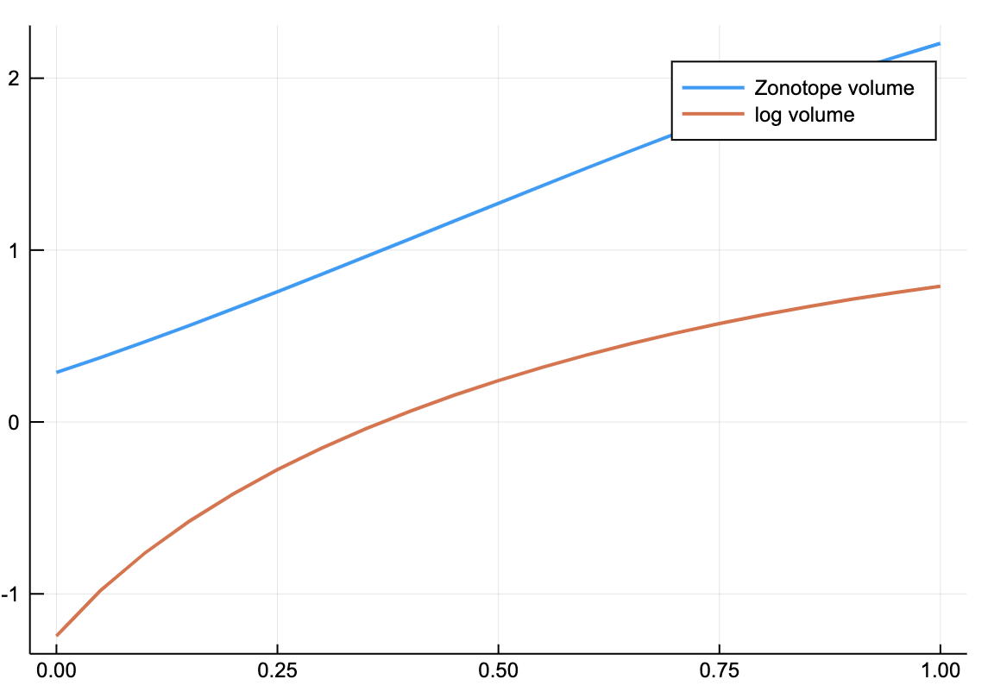
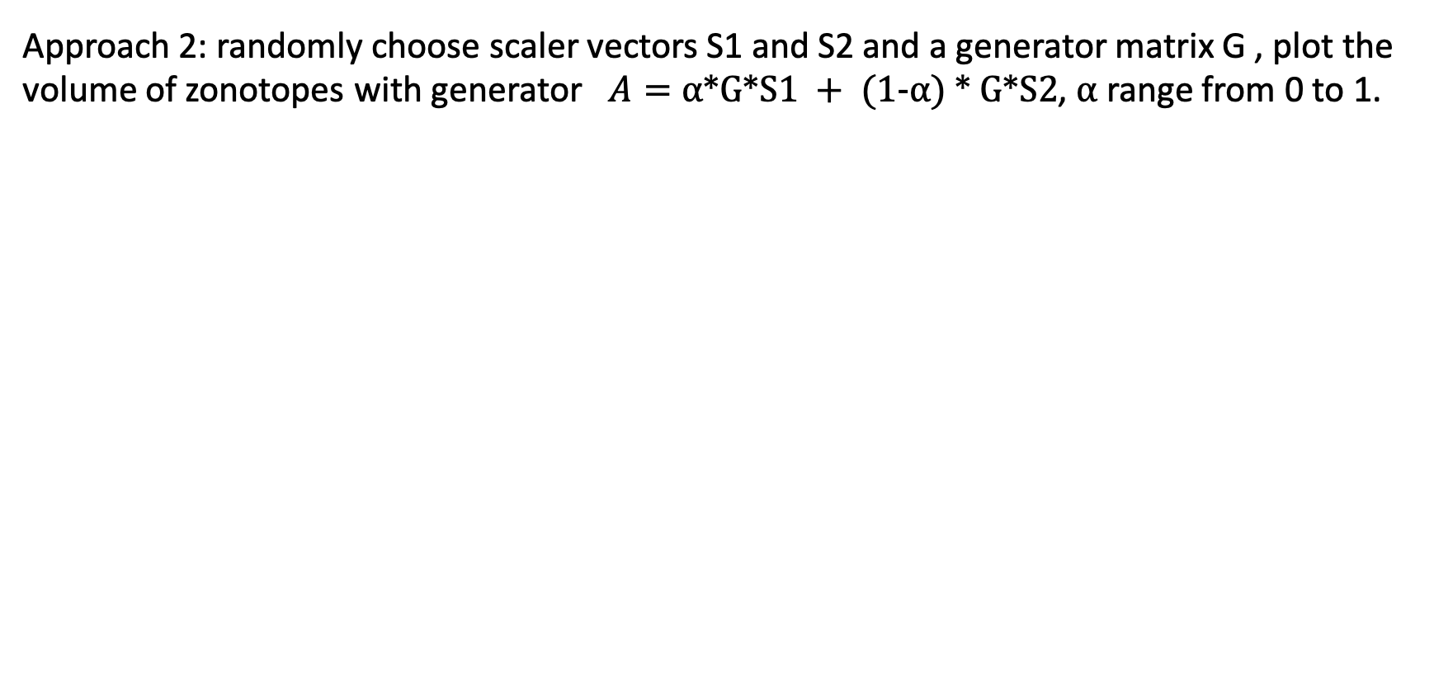
…Is this a convex/concave function?
Approach 2: randomly choose scaler vectors S1 and S2 and a generator matrix G , plot the volume of zonotopes with generator $A=⍺∗G∗S1 + (1−⍺) ∗ G∗S2$, $⍺$ range from 0 to 1.
Tested through dimension 1-6, each with order 1-12, used second order finite difference to test convexity
Log of volume appears to be concave
Unable to test higher dimensions due to runtime

Slide 27
Julia: rapid prototyping and high performance
“…Compiled languages such as C++ offer high performance, but the compilation overhead is inconvenient for prototyping… interpreted languages such as Python offer an interactive session for convenient prototyping, but these languages fall behind in performance.”
“(Julia) reconciles the two advantages of compiled and interpreted languages.”
“Julia is platform independent, is supported in Jupyter notebooks and well-suited for parallel computing ”
[Bogomolov, 2019]

Slide 28
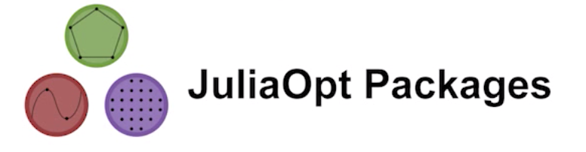
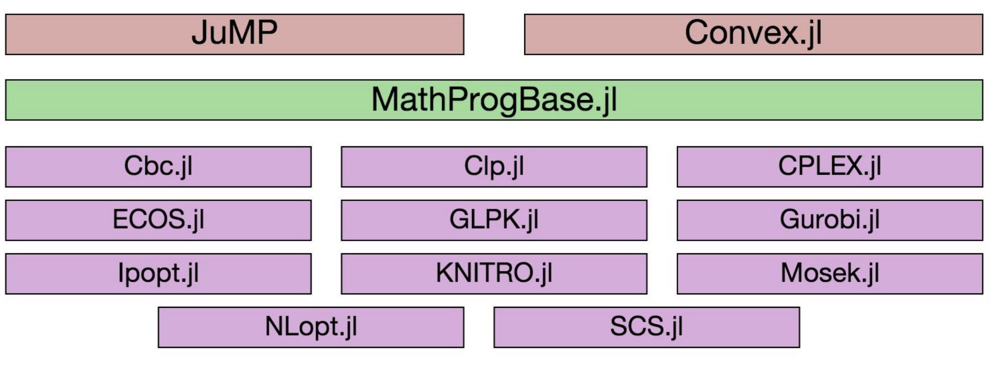
https://www.youtube.com/watch?v=7LNeR299q88
Notes:
MathProgBase : abstraction layer between solvers and modelers

Slide 29
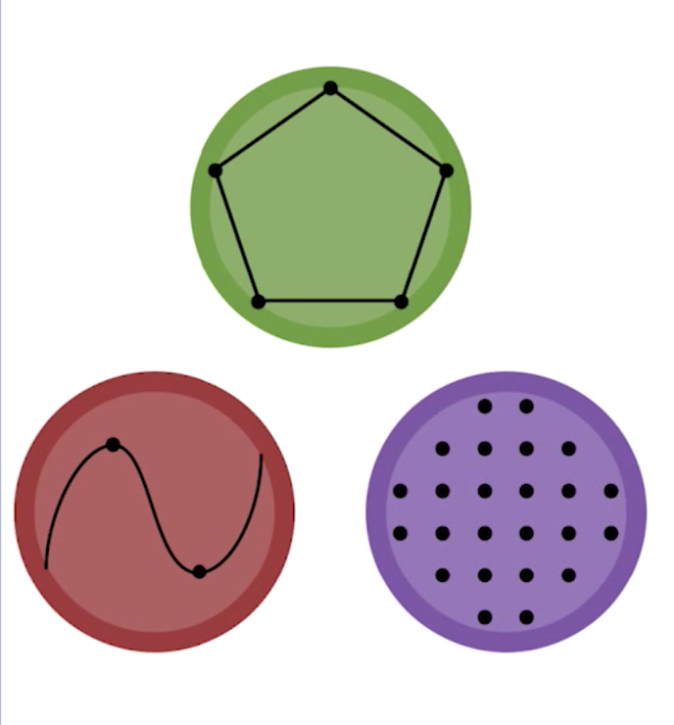
Convex Optimization in Julia Madeleine Udell, Karanveer Mohan, David Zeng, Jenny Hong, Steven Diamond, Stephen Boyd
Notes:
Udell: Assistant Professor Operations Research and Information Engineering (ORIE), Cornell University
Mohan: masters in stanford, working in fb.
Steven Diamond, phd in stanford, developer of CVXPY, Python-embedded modeling language for convex optimization problems.
Stephen Boyd, professor in stanford, chair of electrical engineering.co-author of the book Convex Optimization

Slide 30
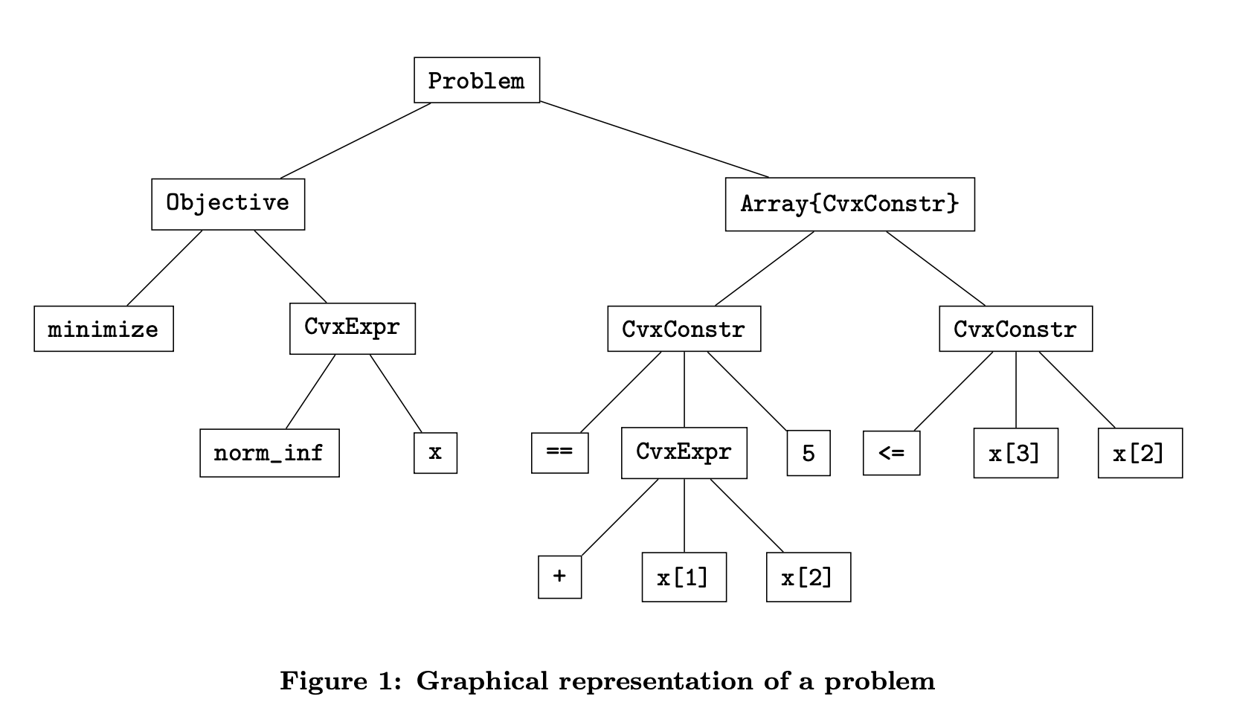

Problem presentation
[Udell, 2014]
Notes:
The solve! method in Convex checks that the problem is a disciplined convex program, converts it into conic form, and passes the problem to a solver

Slide 31


Solving problems
The solve! method in Convex checks that the problem is a disciplined convex program, converts it into conic form, and passes the problem to a solver:
Julia has a rich ecosystem of optimization routines:
[Udell, 2014]

Slide 32

Example
[Udell, 2014]
Notes:
After solve! has been called on problem p, the optimal value of p can be queried with p.optval, and any expression x used in p is annotated with a value, accessible via x.value.

Slide 33

Performance comparison
While the performance of Convex is comparable to CVX and CVXPY at first evaluation, it substantially outperforms upon the second evaluation.
[Udell, 2014]
Notes:
Julia uses just in time (JIT) compilation; the code is compiled at the first evaluation, and the faster compiled version is used on subsequent calls, so the first time a function is called is in general slower than the second time. The third column shows the runtime of the first (uncompiled) evaluation, and the fourth column the second (compiled) time

Slide 34


JuMP: A Modeling Language for Mathematical Optimization Iain Dunning, Joey Huchette, Miles Lubin Winners of the 2016 ICS Prize for Creating the Julia JuMP Optimization Package
Notes:
All three: phd in MIT
Joey: Assistant professor · Rice University
Iain,Miles: working in google

Slide 35
JuMP
Open source and free
Embedded, domain-specific, algebraic modeling language
Supports linear, quadratic and nonlinear (convex and nonconvex) constrained optimization problems.
Supports a number of open-source and commercial solvers (Artelys Knitro, BARON, Bonmin, Cbc, Clp, Couenne, CPLEX, ECOS, FICO Xpress, GLPK, Gurobi, Ipopt, MOSEK, NLopt, SCS)
Very fast
[Dunning, 2015]

Slide 36


[Dunning, 2015]
Notes:
One possible optimal solution to the facility location problem with a four-by-four grid of customers (rectangles) and three facilities (circles). The dotted circles show the maximum distance between any customer and its closest facility, which is the objective.
Visualization of the states (altitude, mass, velocity) and the control (thrust) for a rocket optimal control problem. A natural goal in aerospace engineering is to maximize the altitude attained by a rocket in flight.

Slide 37


[Dunning, 2015]

Slide 38
Optimization Objective
Simpler heuristic used in the paper: Maximizing the sum of the elements of 𝜸 (sum of the “widths” of the generators)
My attempt: true volume of the zonotopes
[Gover, 2010]

Slide 39
Optimization Objective
Simpler heuristic used in the paper: Maximizing the sum of the elements of 𝜸 (sum of the “widths” of the generators)
My attempt: true volume of the zonotopes
[Gover, 2010]

Slide 40
Attempt 1: Finding a convex/concave objective function, and use convex.jl package in Julia.
Test for convexity: randomly choose scaler vectors S1 and S2 and a generator matrix G , plot the volume of zonotopes with generator $A=⍺∗G∗S1 + (1−⍺) ∗ G∗S2$, $⍺$ range from 0 to 1.
Log of volume appears to be concave in automated tests
Unable to test higher dimensions due to runtime

Slide 41

Problem: convex.jl only supports certain operations
Convex.jl currently supports the functions that can be composed according to the DCP composition rules

Slide 42


Problem: convex.jl only supports certain operations
Since “logdet” is recognized, I attempted to use the heuristic:
However, many other operations in the subMatrix function did not work out

Slide 43


Attempt 2: Using JuMP and try to optimize ”non-convex” objective
The heuristic objective function that finally worked out:
Worked with cases with no disturbance and control, similar results to the “sum of widths” heuristic

Slide 44
Possible next steps
Test how close this functions is to the true volume, is it a better heuristic?
If it is a reasonable approximation, try the cases with disturbance inputs
Run in higher dimensions and plot their projections in 2D
Try to implement the true volume function
Prove that the volume function is concave
Clean up and save the code

Slide 45
Work Cited
Dunning, Iain & Huchette, Joey & Lubin, Miles. (2015). JuMP: A Modeling Language for Mathematical Optimization. SIAM Review. 59. 10.1137/15M1020575.
Gover, Eugene & Krikorian, Nishan. (2010). Determinants and the volumes of parallelotopes and zonotopes. Linear Algebra and Its Applications - LINEAR ALGEBRA APPL. 433. 28-40. 10.1016/j.laa.2010.01.031.
Ian M. Mitchell, Jacob Budzis, and Andriy Bolyachevets. 2019. Invariant, viability and discriminating kernel under-approximation via zonotope scaling: poster abstract. In Proceedings of the 22nd ACM International Conference on Hybrid Systems: Computation and Control (HSCC '19). ACM, New York, NY, USA, 268-269. DOI: https://doi.org/10.1145/3302504.3313354
Madeleine Udell, Karanveer Mohan, David Zeng, Jenny Hong, Steven Diamond, and Stephen Boyd. 2014. Convex optimization in Julia. In Proceedings of the 1st First Workshop for High Performance Technical Computing in Dynamic Languages (HPTCDL '14). IEEE Press, Piscataway, NJ, USA, 18-28. DOI=http://dx.doi.org/10.1109/HPTCDL.2014.5
Stephen Boyd and Lieven Vandenberghe. 2004. Convex Optimization. Cambridge University Press, New York, NY, USA.
https://mlubin.github.io/pdf/JuliaOptwebinar.pdf
https://www.youtube.com/watch?v=7LNeR299q88
https://dcp.stanford.edu/rules

Slide 46
Computing Invariant Set via Zonotopes and optimization tools in Julia
Helen Zhang

